Slide 1
CS428 Web Engineering Installation & Architecture (Laravel)

Slide 2
What is Composer?
Composer is a software, that manages PHP dependencies that is package management system and package/class auto loader.
It allows you to declare the libraries your project depends on and it will manage (install/update) them for you.

Slide 3
What is Laravel?
Laravel is a Full-Stack PHP framework.
It has many features such as session management, database management, Composer and many more.
Software Framework: is universal re-usable platform to develop software applications, products and solutions.

Slide 4
MVC and Laravel
The Laravel follows the model-view-controller (MVC) architectural pattern. which enforces a separation between “business logic” from the input and presentation logic associated with a graphical user interface (GUI).
The MVC design pattern is very popular in the web development space.

Slide 5
Model
Models are based on real-world items such as a person, bank account, or product.
E.g. If you were building a blog, your models might be post and comment.
Models are typically permanent and will be stored outside the application, often in a database.
A model is more than just data; it enforces all the business rules that apply to that data.
For example, if a discount shouldn’t be applied to orders of less than $10, the model will enforce the constraint.
The model acts as both a gatekeeper and a data store.

Slide 6
View
The visual representation of a model, given some context.
It’s usually the resulting markup that the framework renders to the browser, such as the HTML representing the blog post.
The view layer is responsible for generating a user interface, normally based on data in the model.
For example, an online store will have a list of products to be displayed on a catalog screen. This list will be accessible via the model, but it will be a view that accesses the list from the model and formats it for the end user.
Although the view may present the user with various ways of inputting data, the view itself never handles incoming data. The view’s work is done once the data is displayed.

Slide 7
Controller
The controller - The coordinator that provides the link between the view and the model.
The controller is responsible for processing input, acting upon the model, and deciding on what action should be performed, such as rendering a view or redirecting to another page.
Continuing the blog example, the controller might look up the most recent comments for a post (the model) and pass them to the view for rendering.

Slide 8
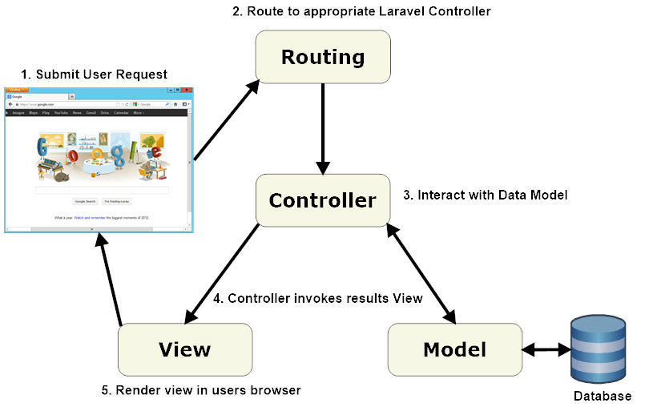
Components of Laravel

Slide 9
Other PHP Frameworks
There are many other PHP frameworks:
Symfony
Yii Framework
Codeigniter
CakePHP
Zend Framework
Aura …

Slide 10
INSTALLTION Overview
So, our general installation plan is, we install laravel and composer on our local machine.
We can develop there, run the web server on local machine.
View those files on our local browser.

Slide 11
Laravel Installation
Step 1:
Open www.laravel.com
Step 2:
Click on Documentation

Slide 12
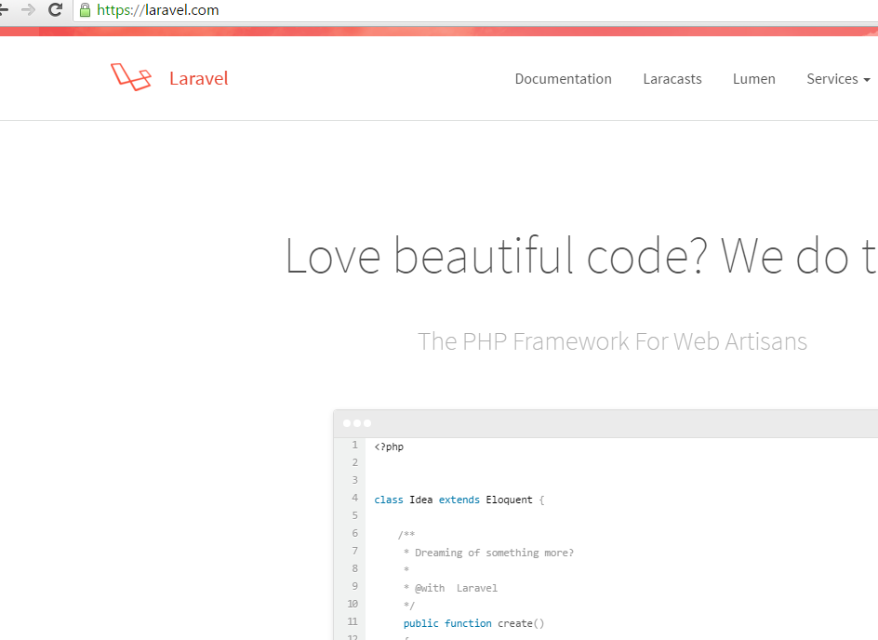

Slide 13
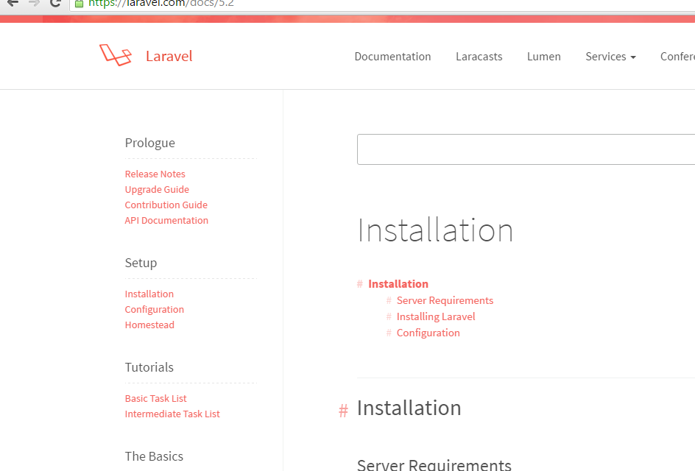

Slide 14
Laravel Installation
First Install Composer
Step 3:
Open www.getcomposer.org
Step 4:
Click on Download button

Slide 15
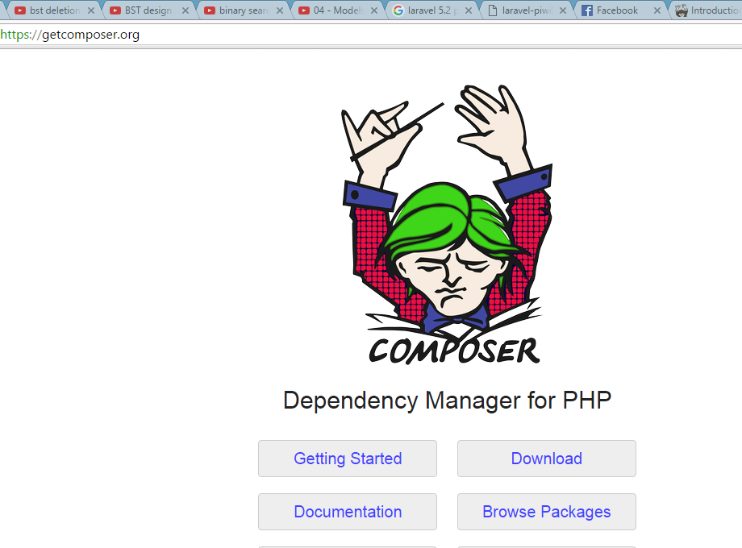

Slide 16
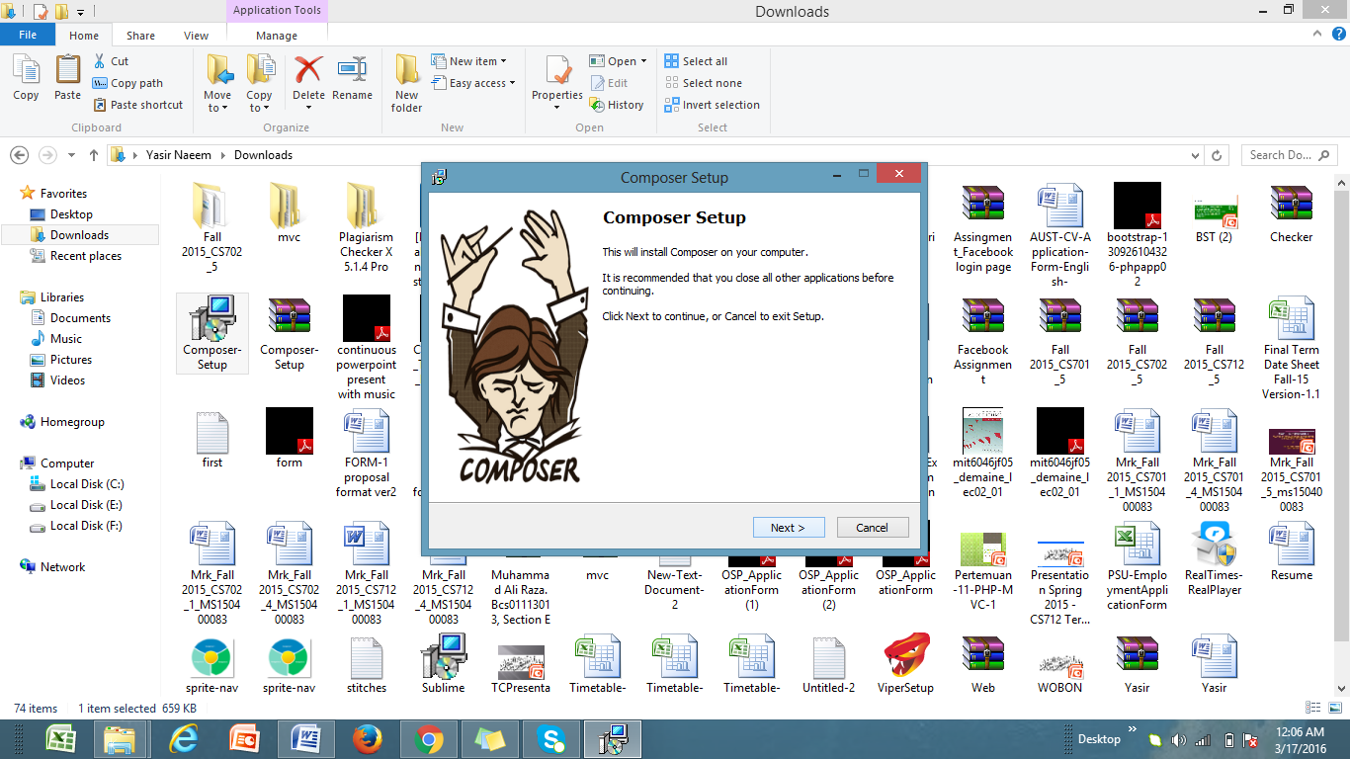

Slide 17
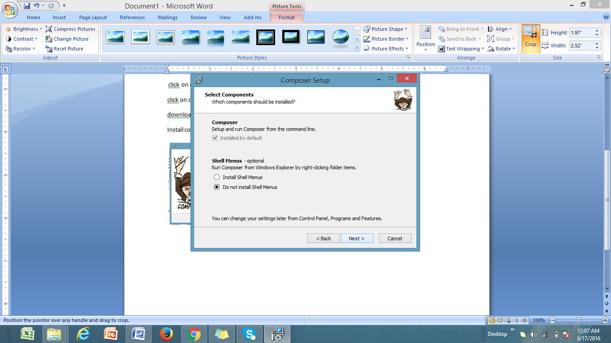

Slide 18
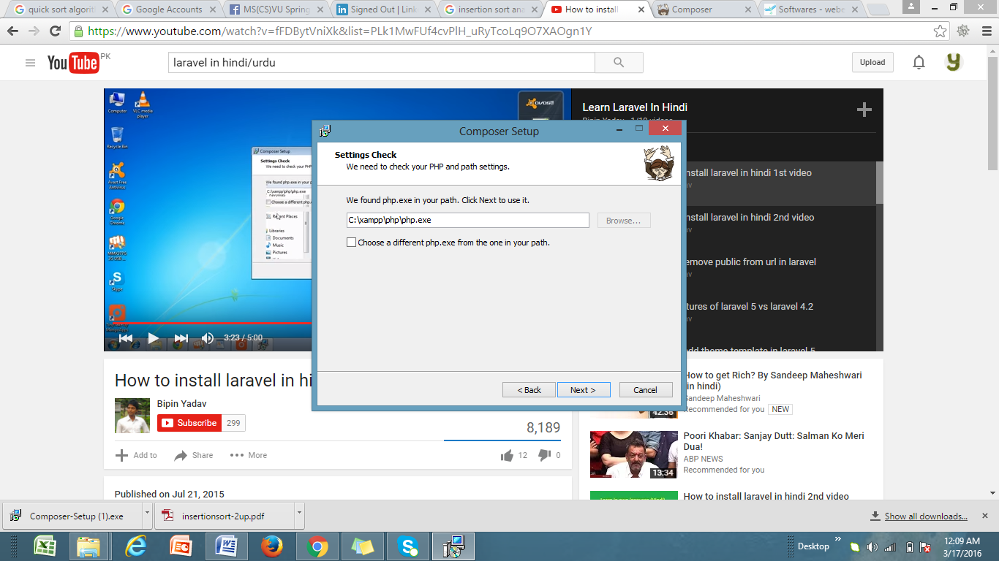

Slide 19
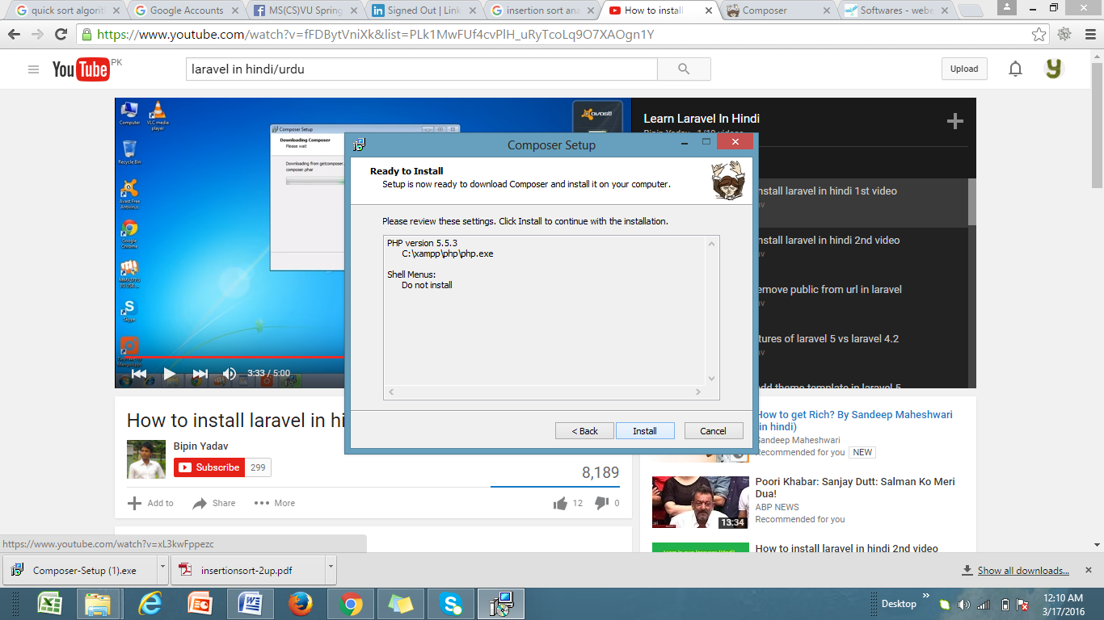

Slide 20
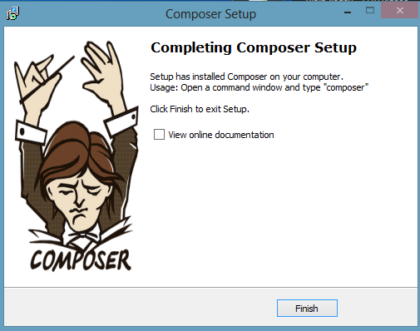

Slide 21
Server Requirements
PHP >= 5.5.9
OpenSSL PHP Extension
PDO PHP Extension
Mbstring PHP Extension
Tokenizer PHP Extension

Slide 22
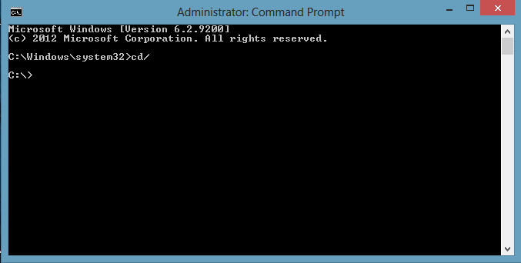
Command Line Interface
Open Command Line Interface (cmd)
Run as Administrator

Slide 23
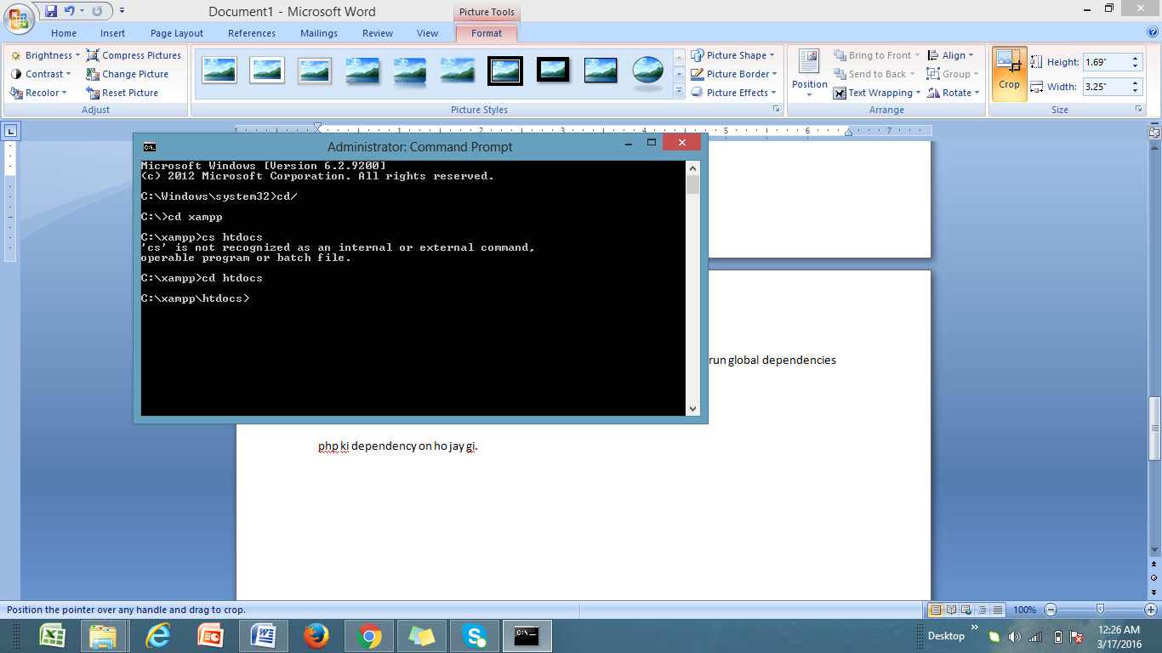
Installation
Locate file location on cmd
After than run global dependencies.
composer global require "laravel/installer"

Slide 24
PHP Dependency
composer global require "laravel/installer“
It ON PHP dependency. It takes some time to install PHP dependency.
After installing PHP dependency it generates “Autoload Files”.

Slide 25
Create New Project
Next step is to create new project.
Type this command to start new laravel project.
composer create-project --prefer-dist laravel/laravel myfirstproject
Here you mentioned the name of the project. E.g. myfirstproject or myblog etc

Slide 26
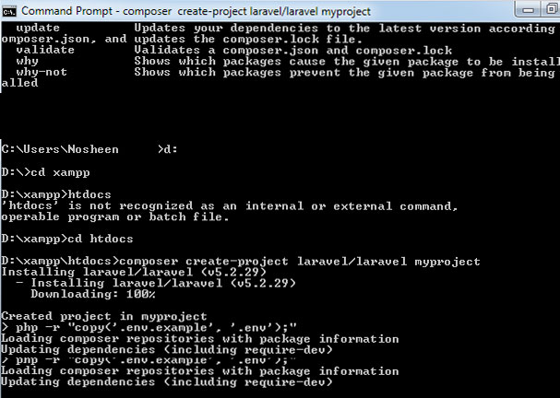

Slide 27
Create New Project
After Installing a new project a key will generate.
To check whether it is installed or not, open browser and type
localhost:8080/myproject
In case you created project with name myfirstproject

Slide 28
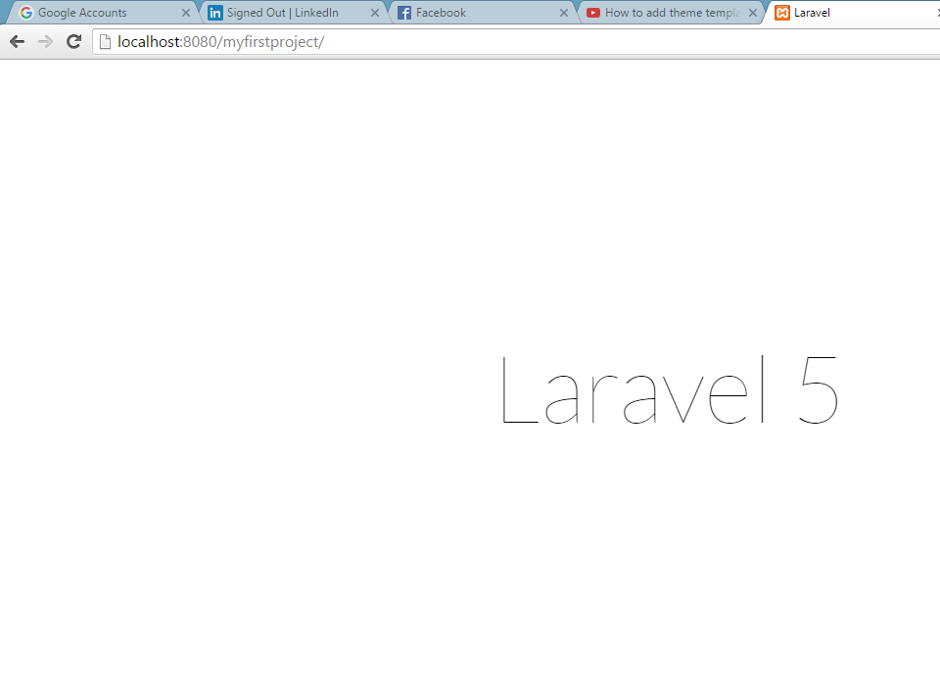

Slide 29
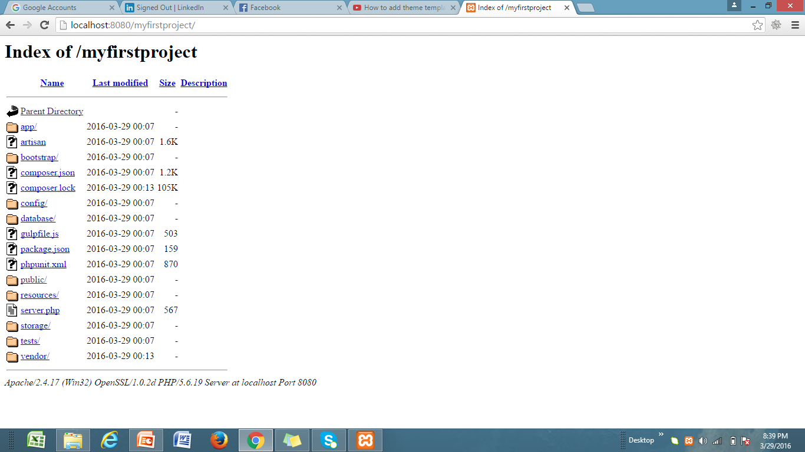
FILE STRUCTURE OF LARAVEL

Slide 30
FILE STRUCTURE OF LARAVEL (1/3)
app folder: is directory that contain our application logic, this is folder where we put our all models, controllers services and many other classes.
bootstrap folder: is used to boostrap laravel and startup laravel.
config folder: where configuration of our application go.
databases folder: where migration and seeds will go.
public folder: where our assets go, these all files that publicly available to our application.

Slide 31
FILE STRUCTURE OF LARAVEL (2/3)
resource folder: this is where all views will lived. Lots of files that front-end user sees, structure of application, they way its look live inside this folder.
storage folder: where all the cache and log files are going to live. This is all builtin with laravel. E.g. error logs and access logs.
test folder: it depends, if you are using any type of unit testing framework, then you can put all test inside this folder.
vender folder: where all third parties library will live, composer packages are going to be installed.

Slide 32
FILE STRUCTURE OF LARAVEL (3/3)
Composer.json: where we define, which composer packages want to include our application.
.env: this is where our database credentials will go and couple of other configuration.
app→Http→routes.php (this is where all routes for application is live)

